Slide 1

CSE 473
Pattern Recognition
Lecturer:
Dr. Md. Monirul Islam

Slide 2
Course Outline
Introduction to Pattern Recognition
Bayesian Classification and its variants
Linear Classifiers: Perceptron Algorithms and its Variants, Linear SVM
Non-Linear Classifiers: Multilayer Perceptrons, Non-Linear Support Vector Machines
Context Dependent Classification
Template Matching
Syntactic Pattern Recognition: Grammar and Graph based Pattern Recognition
Unsupervised Classification: Clustering Algorithms

Slide 3
Course Outcome
have in-depth knowledge and understanding of classical and state-of-the-art pattern recognition algorithms
identify and compare pros and cons of different pattern recognition techniques
analyze real world pattern recognition problems and apply appropriate algorithm(s) to formulate solutions
design and implement core pattern recognition techniques and
develop/engineer new techniques for solutions of real world problems

Slide 4
Assessment
Class Tests: 20%
Attendance:10 %
Term final: 70%

Slide 5
Text Books
Pattern Recognition
  S. Theodoridis & K. Koutrumbas
Pattern Classification
  R. Duda et al.
Pattern Recognition Statistical, Structural and Neural Approaches
  R. Shalkoff
Introduction to Data Mining
  Tan, Steinbach, Kumar

Slide 6
Schedule for Class Tests
* As per central routine

Slide 7
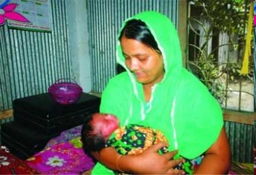
Pattern Recognition: What is it?
Perhaps one of the oldest intelligent arts of living beings

Slide 8
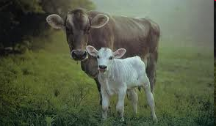
Pattern Recognition: What is it?
Perhaps one of the oldest intelligent arts of living beings

Slide 9

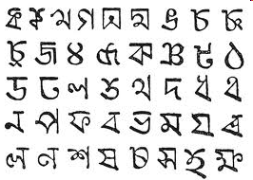
Pattern Recognition: What is it?
Perhaps one of the oldest intelligent arts of living beings

Slide 10
What Does It Do?
Build a machine that can recognize patterns.
The task: Assign unknown objects – patterns – into the correct class. This is known as classification.

Slide 11
What Does It Do?
Areas:
  Machine vision
  Character recognition (OCR)
  Computer aided diagnosis
  Speech recognition
  Face recognition
  Bioinformatics
  Image Data Base retrieval
  Data mining
  Biometrics
    Fingerprint identification
    Iris Recognition
  DNA sequence identification

Slide 12
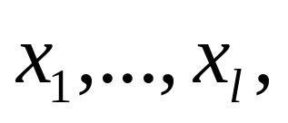
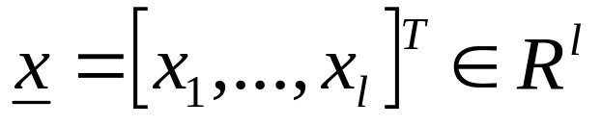
Representation of patterns
Features:
  measurable quantities from the patterns
  determines the classification task
Feature vectors: A number of features
constitute the feature vector
Feature vectors are treated as random vectors.

Slide 13
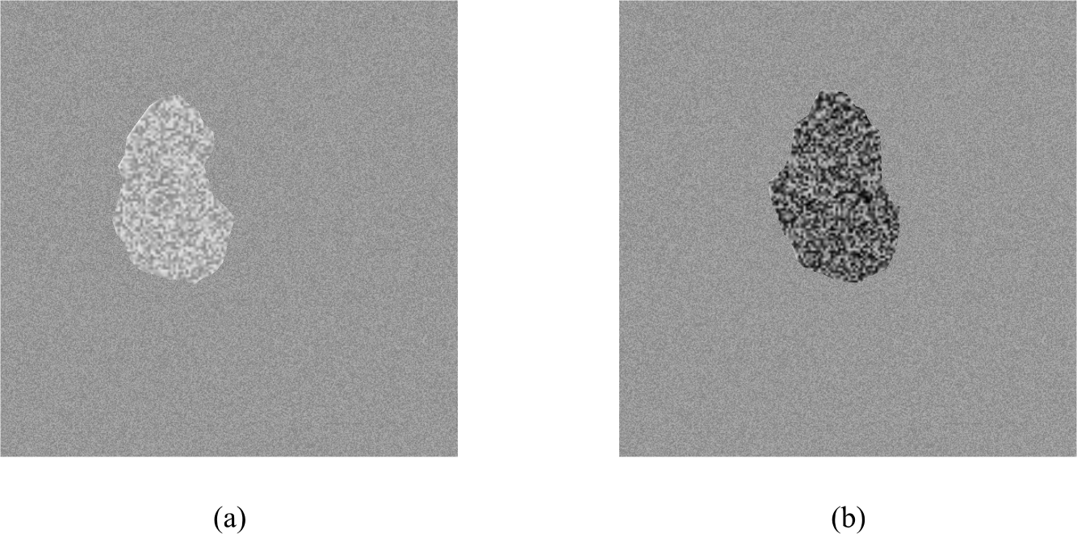
Example 1:

Slide 14
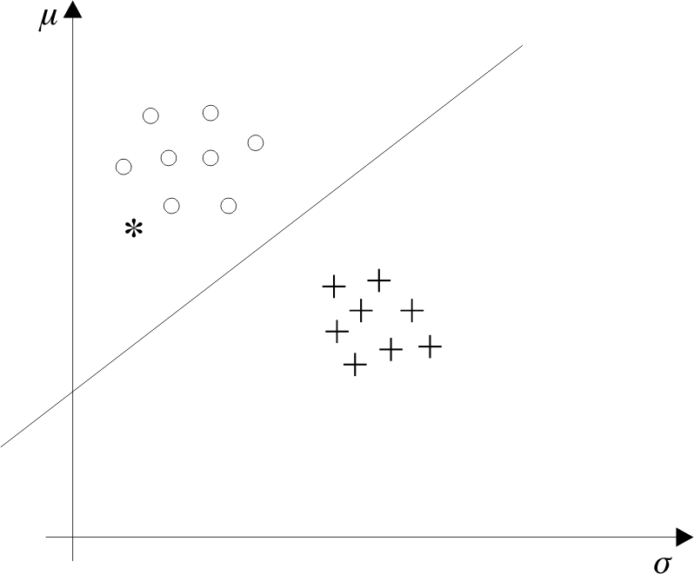
Example 1:

Slide 15
Example 1:

Slide 16
Issues in Pattern Recognition
How are features generated?
What is the best number of features?
How are they used to design a classifier?
How good is the classifier?

Slide 17
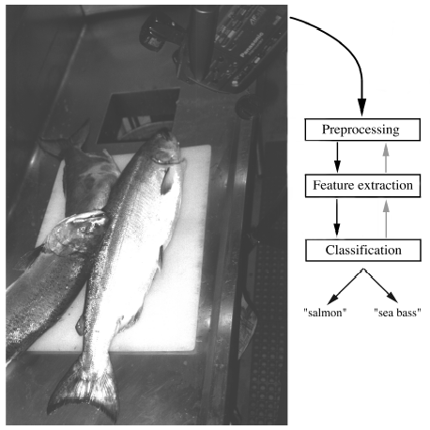
Example 2
“Sorting incoming Fish on a conveyor according to species using optical sensing”
Sea bass
Species
Salmon

Slide 18
Problem Analysis
  Set up a camera and take some sample images to extract features
    Length
    Lightness
    Width
    Number and shape of fins
    Position of the mouth, etc…

Slide 19
Preprocessing
  isolate fishes from one another and from the background
Feature Extraction
  send isolated fish image to feature extractor
  it reduces the data, too
Classification
  pass the features to a classifier

Slide 21
Classification
  Select the length of the fish as a possible feature for discrimination

Slide 22
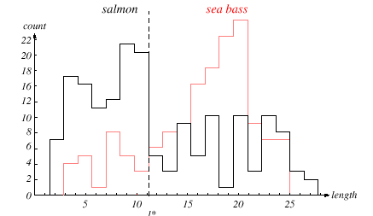
x*

Slide 23
x*

Slide 24
x*

Slide 25
The length is a poor feature alone!
Select the lightness as a possible feature.

Slide 26
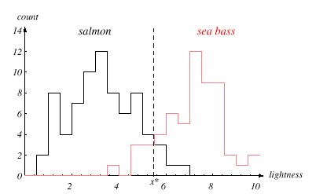

Slide 29
Decision boundary and cost relationship
  Move decision boundary toward smaller values of lightness in order to minimize the cost (reduce the number of sea bass that are classified as salmon!)
  Task of decision theory

Slide 30
Adopt the lightness and add the width of the fish
Fish x^{T} = [x₁, x₂]
Lightness
Width

Slide 31
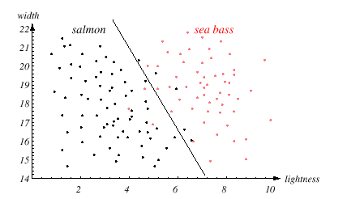

Slide 33
adding correlated feature does not improve anything and is thus redundant
too many features may lead to curse of dimensionality

Slide 34
still there are some misclassifications

Slide 35
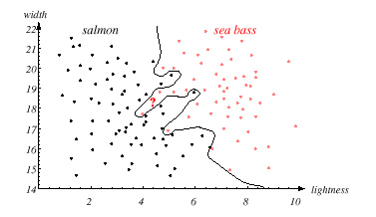
perhaps the best one, but too complex decision boundary

Slide 36
satisfaction is premature
  cause: aim of a classifier is to correctly classify unknown input
Issue of generalization!

Slide 37
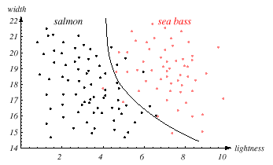
A compromise between training and testing

Slide 38
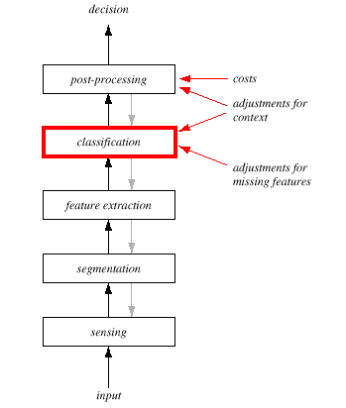
Pattern Recognition System

Slide 39
Pattern Recognition System
Sensing
  Use of a transducer (camera or microphone)
  PR system depends on the bandwidth, the resolution sensitivity distortion of the transducer
Segmentation and grouping
  Patterns should be well separated and should not overlap

Slide 40
Feature extraction
  Discriminative features
  Invariant features with respect to translation, rotation and scale.
Classification
  Use a feature vector provided by a feature extractor to assign the object to a category
Post Processing
  error rate
  risk
  use context

Slide 41
The Design Cycle
Data collection
Feature Choice
Model Choice
Training
Evaluation
Computational Complexity

Slide 42
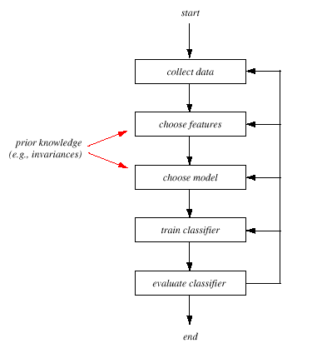

Slide 43
Data Collection
  How do we know when we have collected an adequately large and representative set of examples for training and testing the system?

Slide 44
Feature Choice
  Depends on the characteristics of the problem domain.
  Requirement
    simple to extract
    invariant to irrelevant transformation
    insensitive to noise.

Slide 45
Model Choice
  too many classification models?
  which one is best?

Slide 46
Training
  Use data to determine the classifier. Many different procedures for training classifiers and choosing models

Slide 47
Evaluation
  Measure the error rate (or performance) and switch from one set of features to another

Slide 48
Computational Complexity
  What is the trade-off between computational ease and performance?

Slide 49
Supervised vs. Unsupervised Learning
Supervised learning
  A teacher provides a category label or cost for each pattern in the training set
Unsupervised learning
  The system forms clusters or “natural groupings” of the input patterns

Slide 50
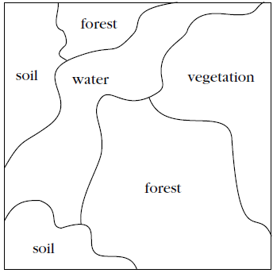

Unsupervised Learning

Slide 51
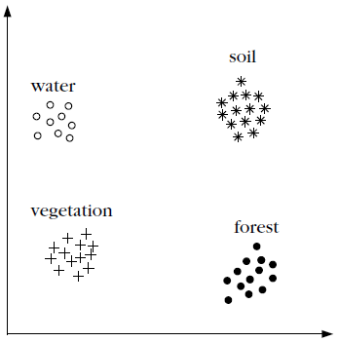
Unsupervised Learning
x₁
x₂

Slide 52
Unsupervised Learning
x₁
3
2
1
2
1
4
4
3
3
2
x₂

Slide 53
Unsupervised Learning
x₁
Forest
Water
Vegetation
Soil
Forest
Soil
x₂

